Slide 1
VETCON BADGE
Team 32
Derek Barbosa, John Kircher, Carlos Ortiz, Julian Padgett, Ryan Sullivan
Notes:
Julian 2-6

Slide 2
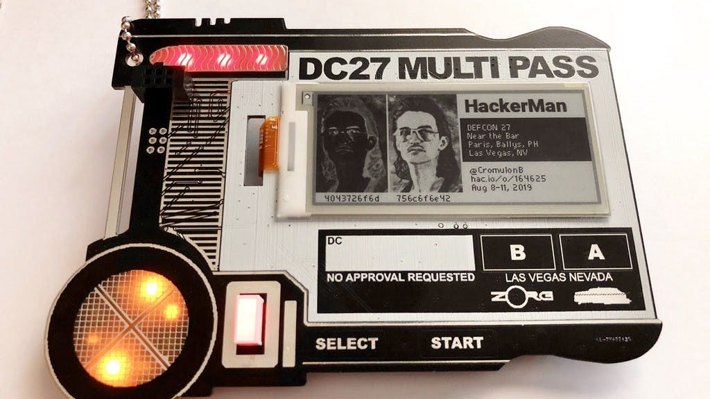
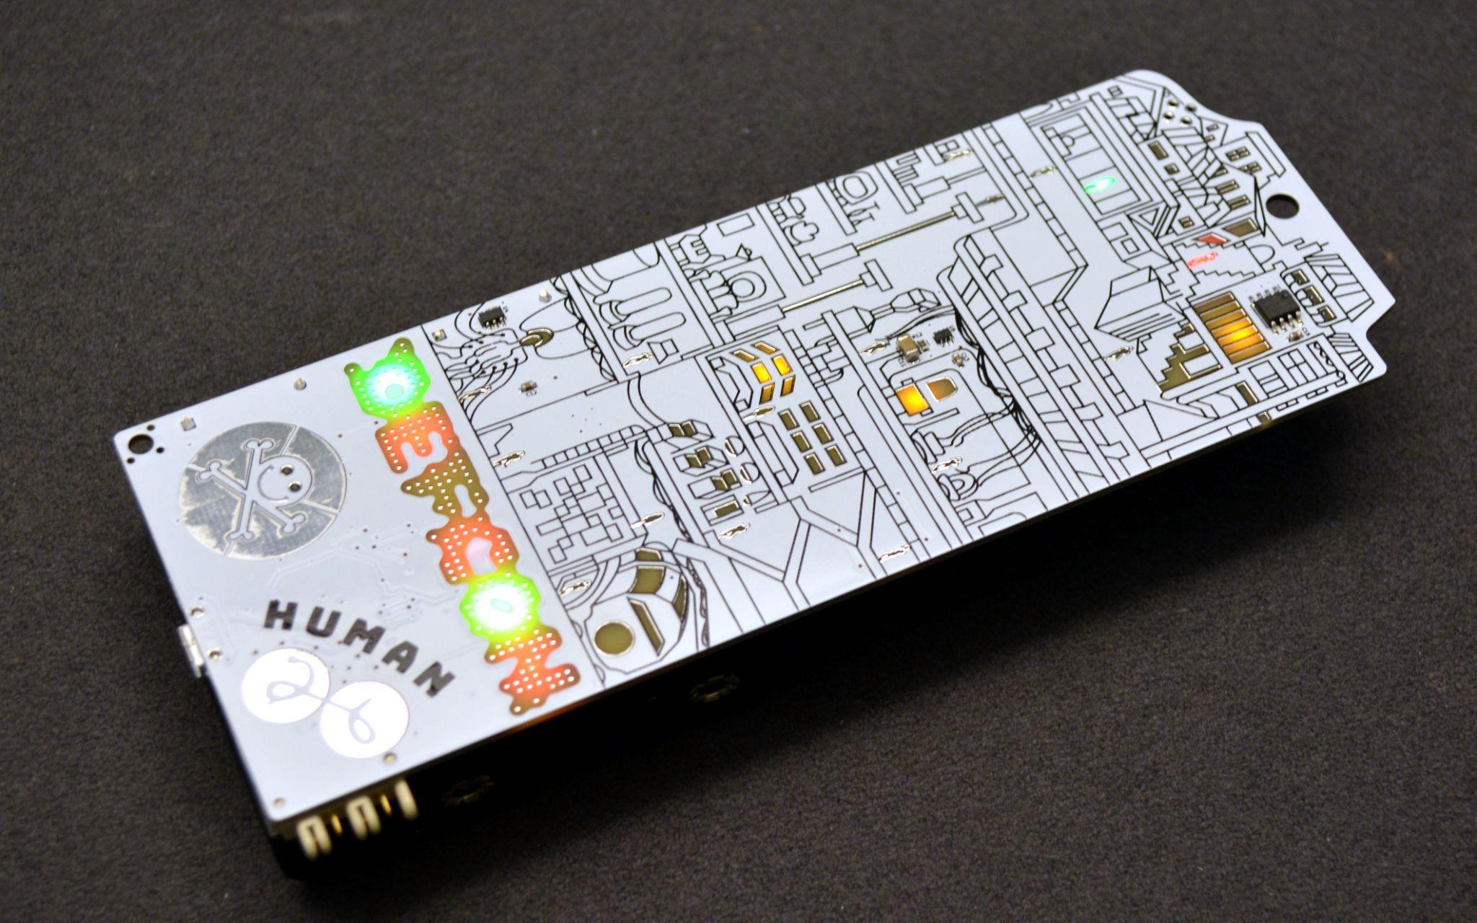
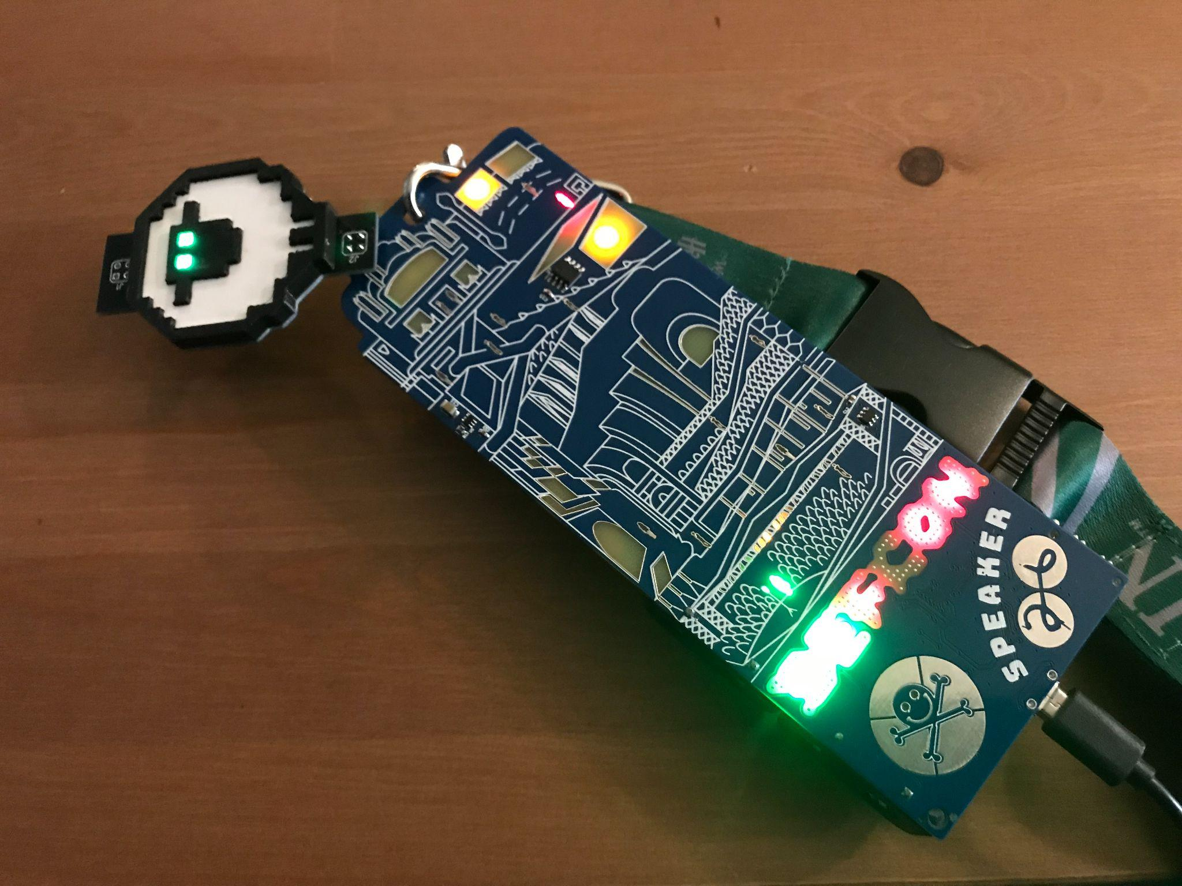
Our Project
What are we actually doing?
Providing a detailed blueprint for an identification “badge” to be used by VETCON in the upcoming DEFCON conference that sticks with a Cybersecurity theme.
Notes:
Julian

Slide 3
What does this entail?
“Providing a detailed blueprint for an identification “badge” to be used by VETCON in the upcoming DEFCON conference that sticks with a Cybersecurity theme.”
Notes:
julian

Slide 4
Concepts
Intent
Purpose
Design a “working schematic” for a DEFCON badge.
Construct a sophisticated manual with Bill of Materials
Badge will provide customizable identification for VETCON attendees
Badge will also prove as a collection of interactive minigames on a consistent hardware “platform”
Notes:
julian

Slide 5
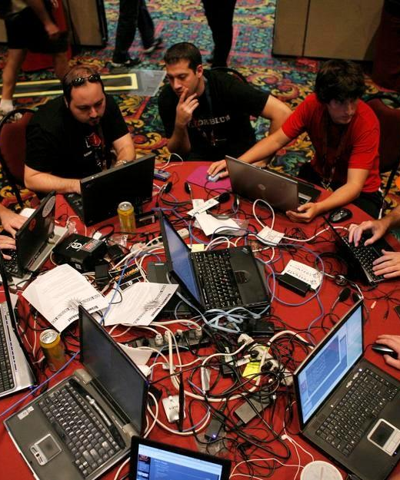
What is DefCon?
The world's longest running and largest underground hacking conference.
Notes:
julian

Slide 6
Problem Statement
VETCON wants a unique, functional, and production ready badge for DefCon 30
--
Our Client (VETCON): a group of information security professionals who have served in the armed forces of the United States or close allies.
Notes:
Julian

Slide 7

Deliverables
Functional Badge
Bill of Materials
Working badge that meets all design constraints
Accurate bill of materials for badge production
Badge Manual
Badge Production
Assembly & installation instructions, troubleshooting procedures, microcontroller flashing
Process for mass badge production
Notes:
Ryan 7- 11

Slide 8
Requirements: Functions
Communication
Provide users with easy communication with other badges users
Badge Functions
Construction
Easy but rewarding construction of badges
Cost & Production
An affordable price for those hoping to order a badge
Notes:
ryan

Slide 9
Requirements: Objectives
Point-Point Networking
USB-C
Communication between two endpoints
Charging, data transfer, software flashing
1
2
3
4
5
Operating System
Battery Life
Interface Switch
System software to manage our microcontroller(s) and ROMs
Ability to operate for 21 hours; 𝞂 = 2.1
On/Off/Data Transfer Switch
Notes:
ryan

Slide 10
Requirements: “Stretch Goals”
SMDs
Puzzle Game
Any other surface mount device
Interactive game that unlocks achievements
6
7
8
9
10
LEDs
Wireless Mesh
Color Display
Configurable and addressable indicator lights
Communications network made of radio nodes
320 x 240 pixel display
Notes:
ryan

Slide 11
Requirements: Constraints
Size
Weight
Lanyard
4” wide, 4” long, 1” deep
150 grams
Attachment points for wearing
Notes:
ryan

Slide 12
Describing Our Technical Approach
Notes:
Derek 12 -15

Slide 13

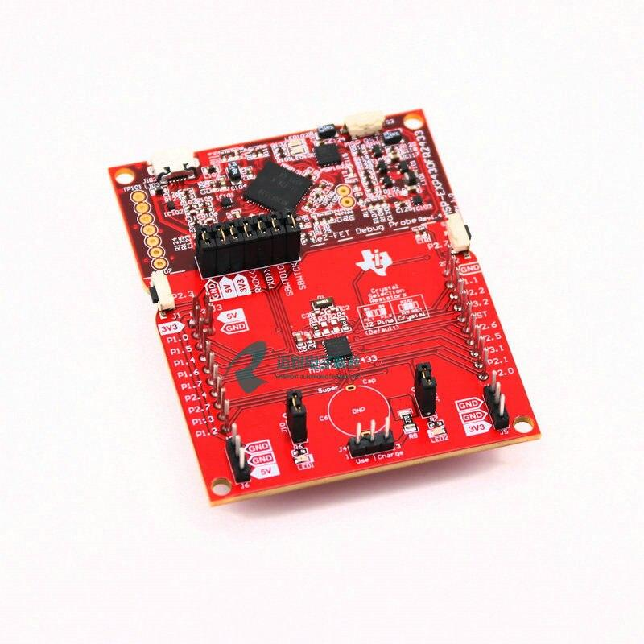
Arduino Minis
Systems On a Chip (SOC)
TI MSP430XXX
An IC that includes “most” circuit components of -a- Computer / Electronic System.
+”Sandboxed” Dev Environment
+Rapid Prototyping Capabilities (fast compile)
-Software Suite heavily dependent on Manufacturer.
-Reliant on Community for implementation
Notes:
derek

Slide 14
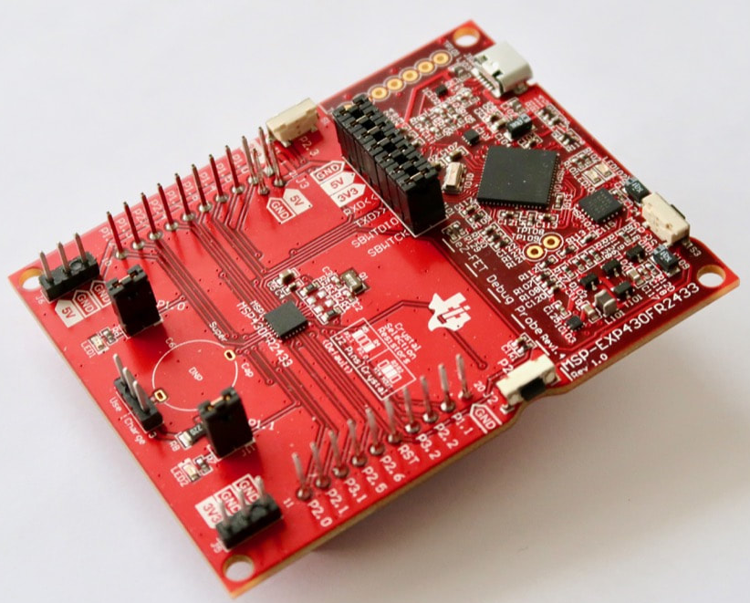
Our Decision
Why?
TI MSP430
Best balance between “efficient” and pliable.
+Maintains excellent power efficiency
+Approachable programming interface
+Based in the US (faster shipping).
Notes:
derek

Slide 15
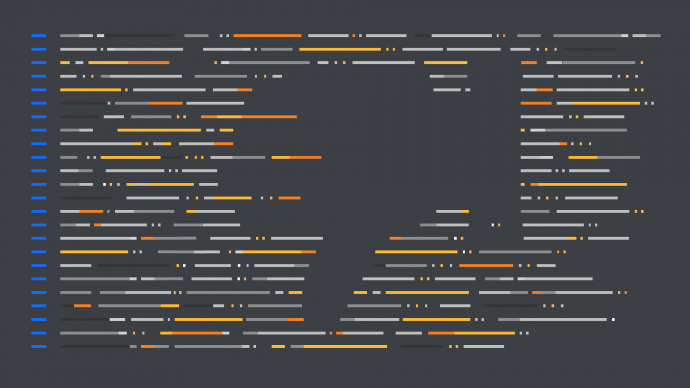
IDEs make a HUGE difference
Notes:
Derek 15

Slide 16
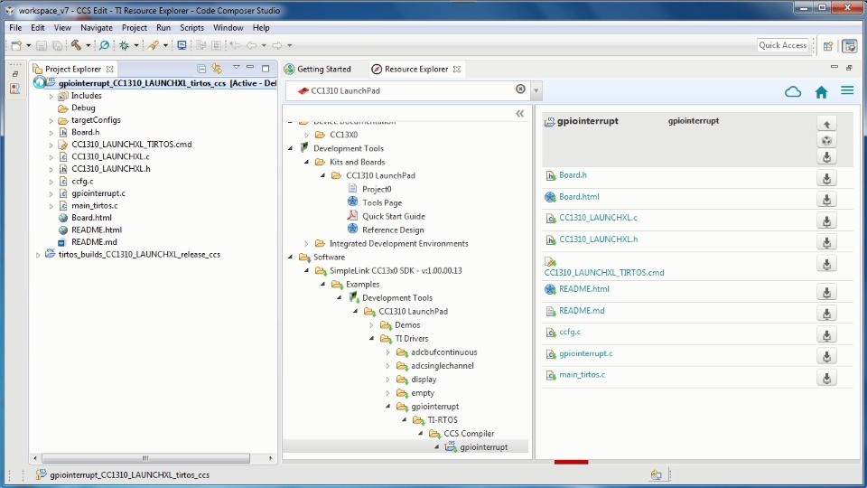
First Hurdles: CCStudio
At first, CCStudio seemed like a fantastic IDE for our group to use as it was TI’s IDE built specifically for use with the MSP, but many issues arose when it came time to begin coding
Slow to debug
Lack of support from TI
Low amount of user-made libraries
Runs extremely slow
Due to this, our group was forced to find an alternative, as using CCStudio had already resulted in a delay of about two to three weeks
Notes:
John 16

Slide 17
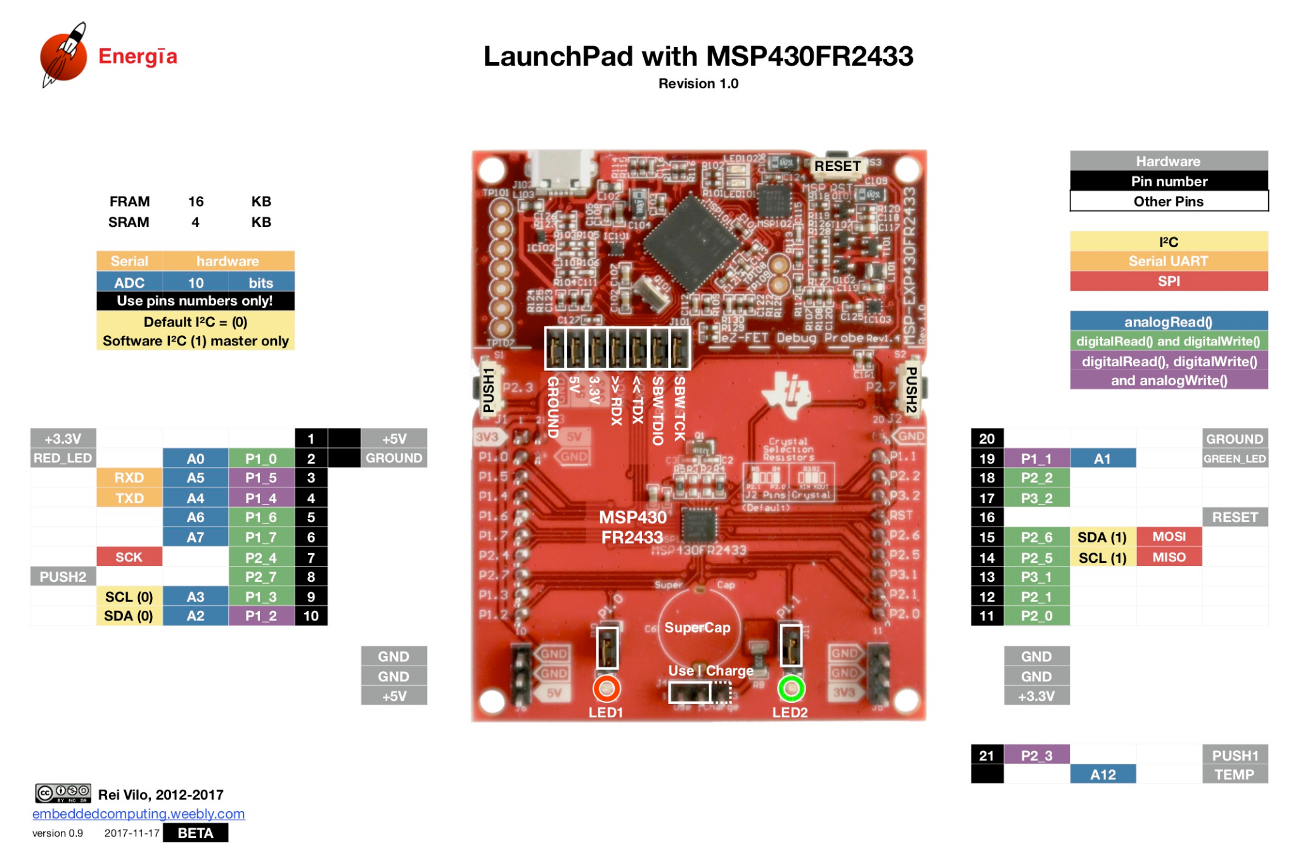
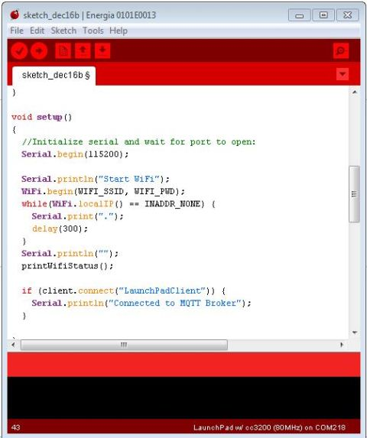
Next best thing: Energia
A FOSS IDE supported by TI to bring together the Wiring project and Arduino to create a portable programming platform.
Compatible with all MSPs
Easy programming interface (C++, Arduino, less macros)
Built in sketches/demos for sanity check
Faster building and compiling
While we didn’t end up sticking with this option, it was a good transition point that provided an amazing pin diagram that *actually* is a good working piece of documentation
Notes:
John

Slide 18
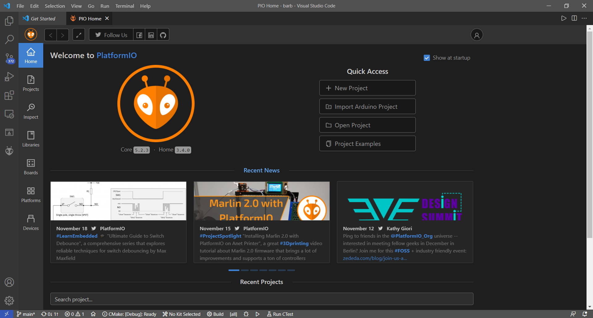
Our Saving Grace: PlatformIO
PlatformIO is an extension built directly into VSCode. It allows us to code, build, upload, and debug any code written almost instantly.
All the benefits of Energia
Lightweight VSCode extension
Support for cross-platform 3rd party libraries (most)
Lightning fast automated build and flash process with dedicated Serial Monitor for debugging
Notes:
Derek

Slide 19
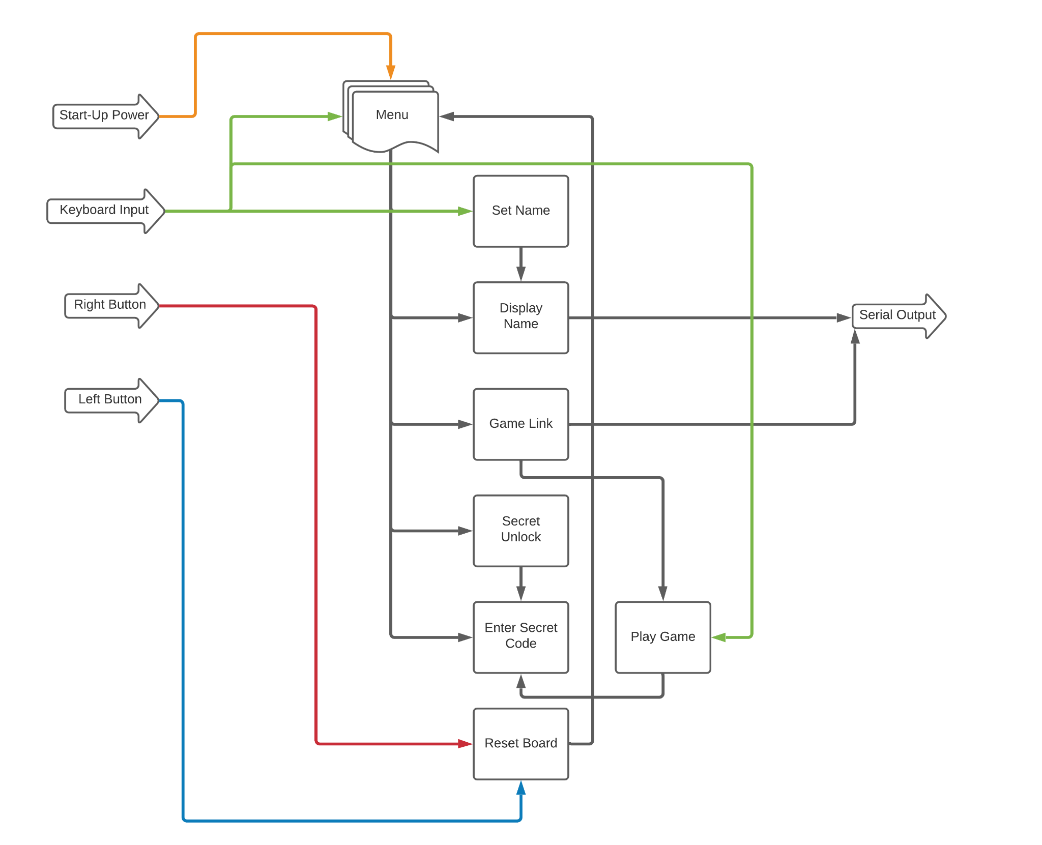
System Block Diagram
Notes:
Carlos

Slide 20
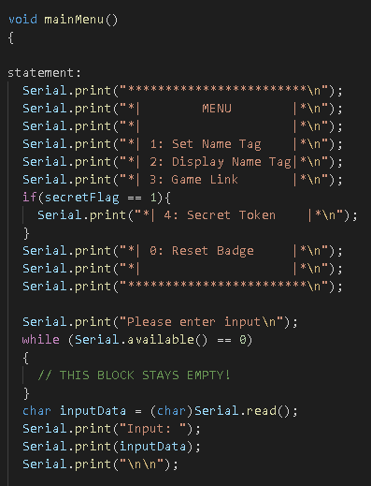
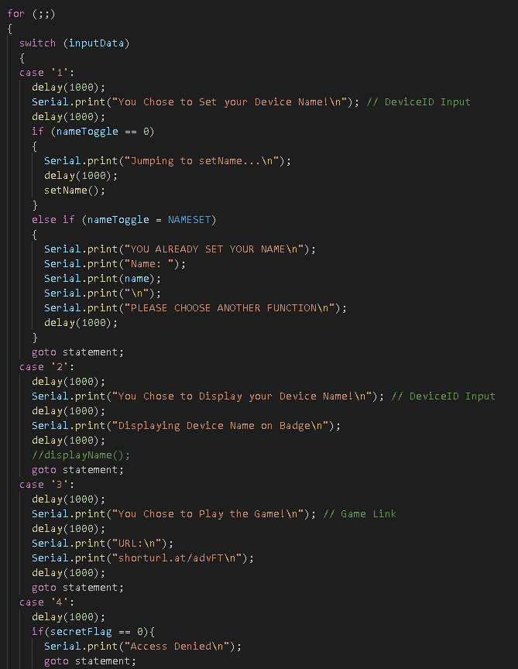
Code Overview: Main Menu
Notes:
Carlos 20-22

Slide 21
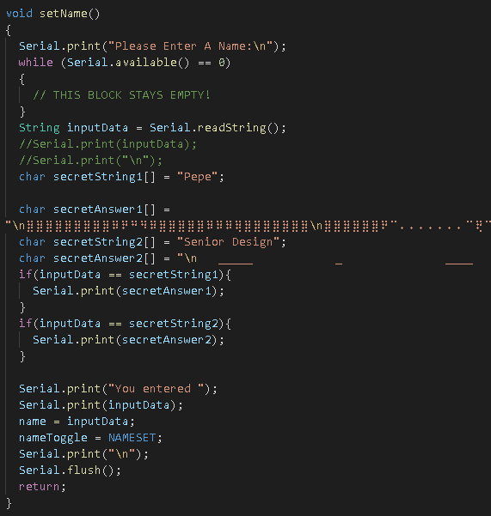
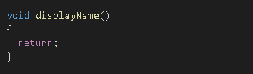
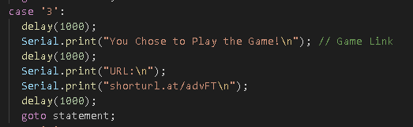
Code Overview: Set/Display Name, Game Link
Notes:
Carlos 21

Slide 22
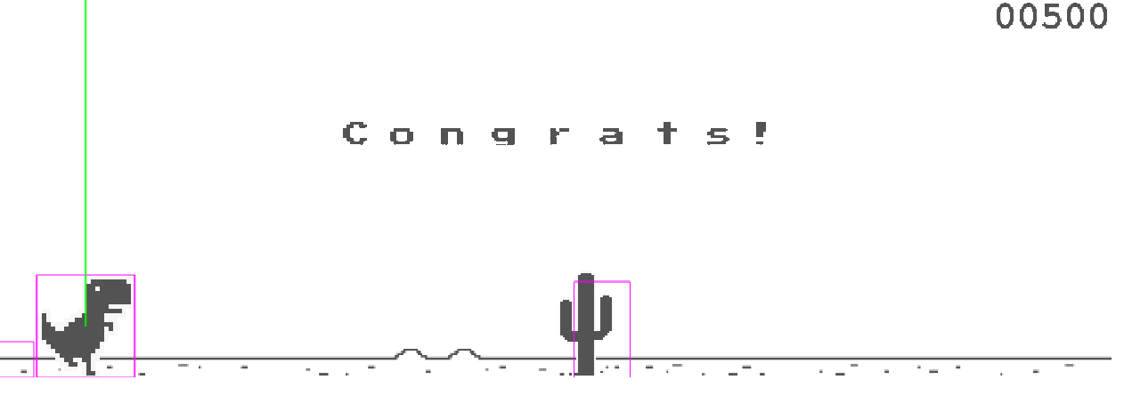
Game Screenshot
Notes:
Carlos 22

Slide 23
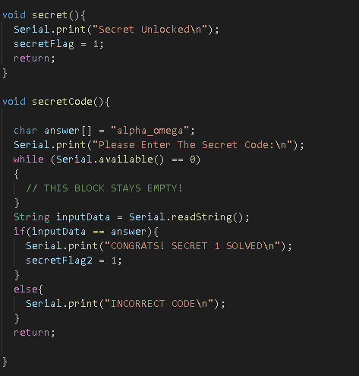
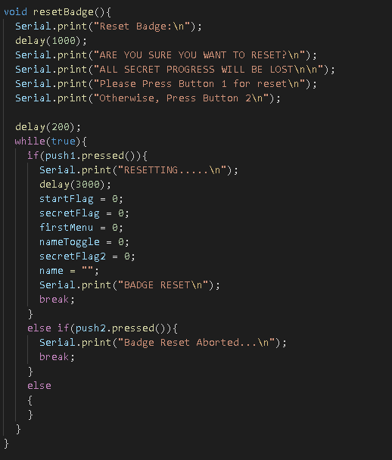
Code Overview: Secret & Reset
Notes:
John 23-25

Slide 24
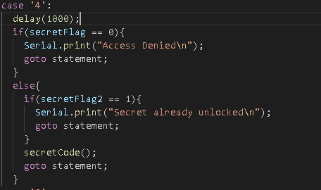
Code Overview: Secret cont...
Notes:
John 24

Slide 25
Thank You

